Slide 1

ETHICAL HACKING INTERNSHIP TASK-2
Name-Ankush Bagchi

Slide 2
Project Problem Statement(Task-2)
Task 2: http://zero.webappsecurity.com/
We have set up a real life-like web application in the form of an online bank portal. Your task is to test this website and find all possible vulnerabilities and loopholes in it.
To do so you can use the automatic vulnerabilities scanner “Netsparker” which was taught to you in the session of Automatic Vulnerability Scanner.
If you want you can download it using this link: . https://drive.google.com/drive/folders/193Ha6QVU9Joh-rhhOvH78HrTNO1OgaMx?usp =sharing
You have to find 3 critical vulnerabilities. No matter if they are taught to you or not. Now just choose any 1 amongst that 3 and write a report in your own language.
If you are using Netsparker you can use the report already generated by software but make sure you do not have to copy it. You have to then submit the report generated by you.

Slide 3
Vulnerability Statistics
Critical
8%
Severe
11%
Moderate
16%
Low
37%

Slide 4
Vulnerabilities:
No | Severity | Vulnerability | Count
1 | Critical | SQL Injection | 1
2 | Critical | Access to sales dashboard | 1
3 | Critical | Access to admin panel | 1

Slide 5
1. Out-of-date Version (Apache)
Out-of-date Version (Apache) (Critical) | Impact Since this is an old version of the software, it may be vulnerable to attacks. Remedy Please upgrade your installation of Apache to the latest stable version. Remedy References Downloading the Apache HTTP Server Known Vulnerabilities in this Version Apache HTTP Server Improper Neutralization of Input During Web Page Generation ('Cross-site Scripting') Vulnerability Cross-site scripting (XSS) vulnerability in balancer-manager in mod_proxy_balancer in the Apache HTTP Server 2.2.0 through 2.2.6 allows remote attackers to inject arbitrary web script or HTML via the (1) ss, (2) wr, or (3) rr parameters, or (4) the URL.

Slide 6
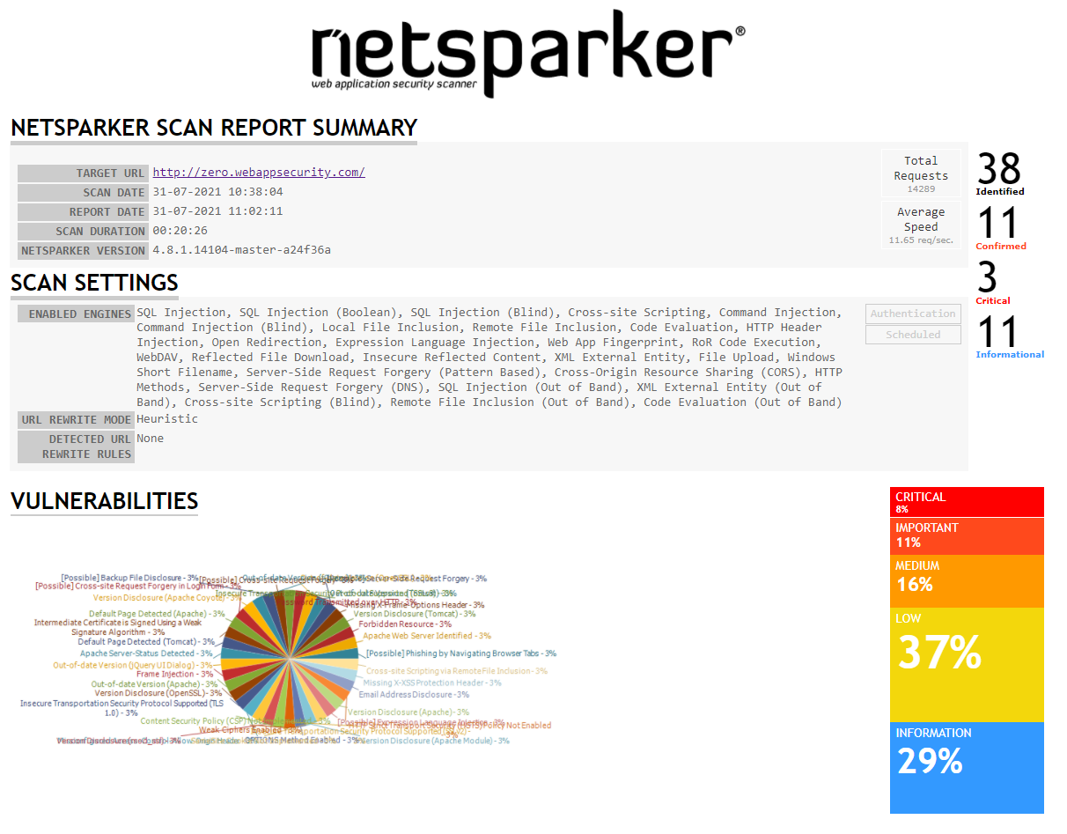
Netsparker Report

Slide 7
THANK YOU

